Slide 1
brief introduction to Machine Learning
Created By: Abdus Salam Azad
Modified By: Md. Ashraful Islam & Kowshic Roy

Slide 2

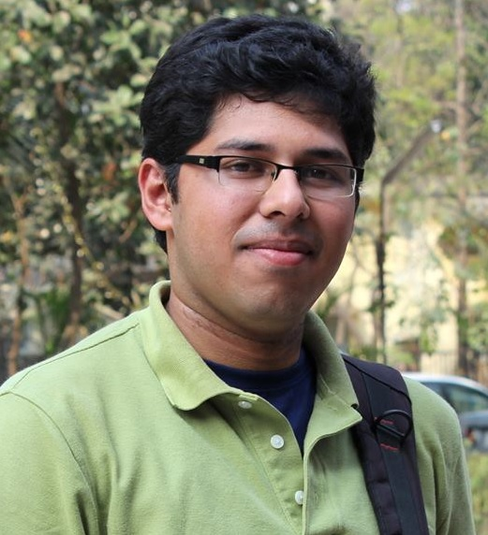
Introduction to Machine Learning
Instructors:
1. Kowshic Roy
Lecturer
Dept. of CSE, BUET
Email: kowshic@cse.buet.ac.bd
Mobile no.: 01521249494
2. Dr. Ch. Md. Rakin Haider
Assistant Professor
Dept. of CSE, BUET
Email: rakinhaider@cse.buet.ac.bd
Mobile no.: 01758433668

Slide 3
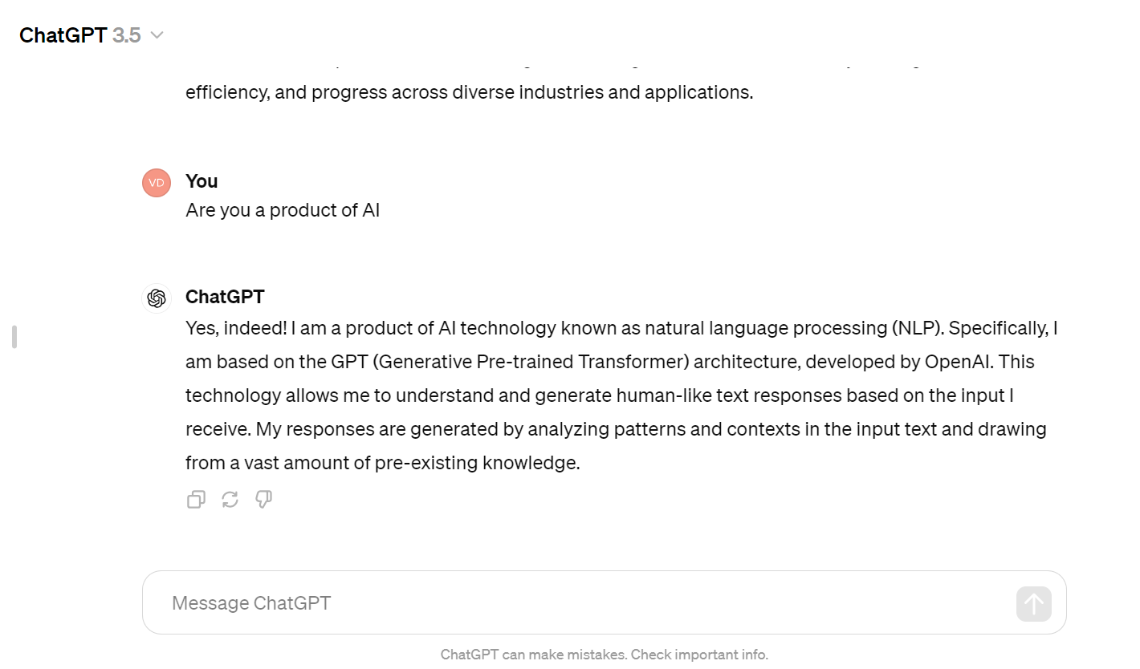
ChatGPT

Slide 4

Relationship between Some Popular Terms
Image_source

Slide 5
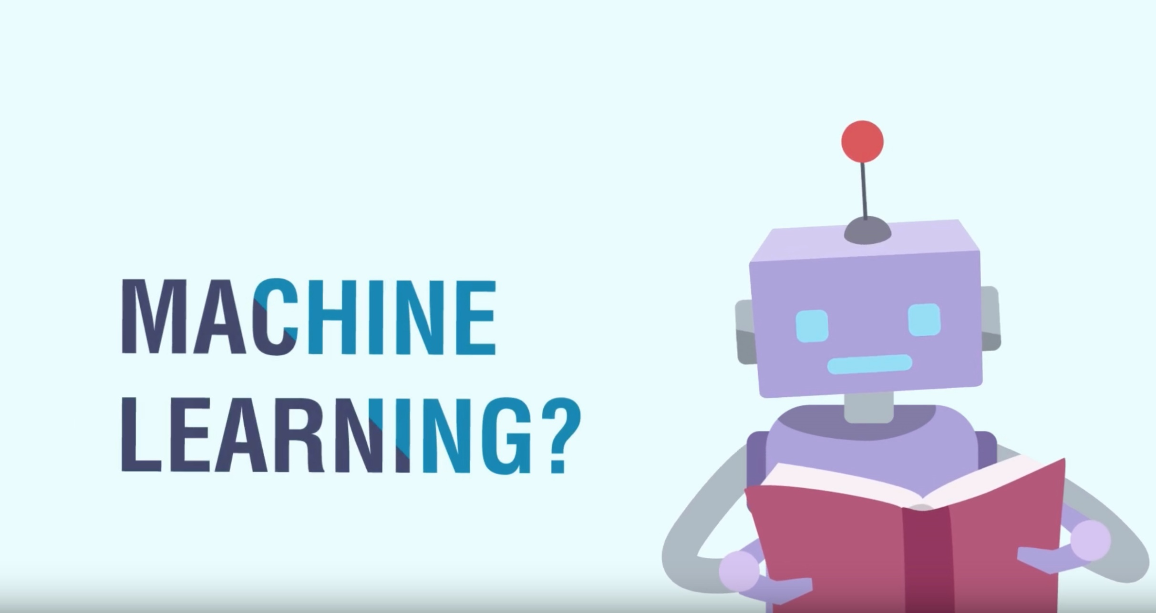

Slide 6
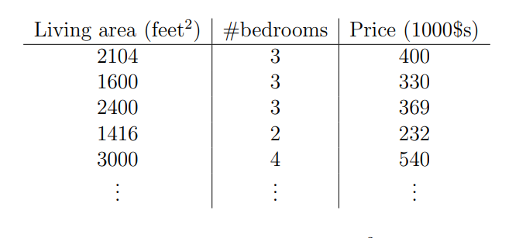
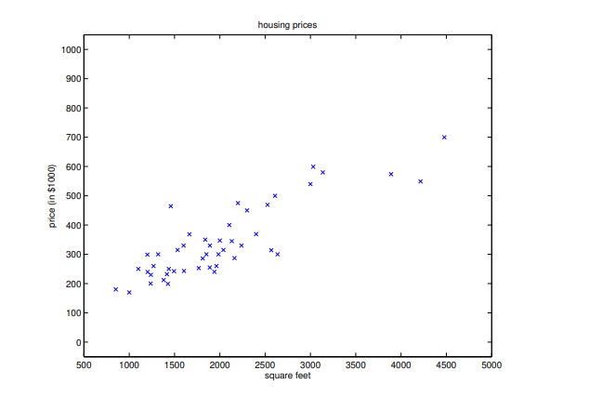
House Rent

Slide 7
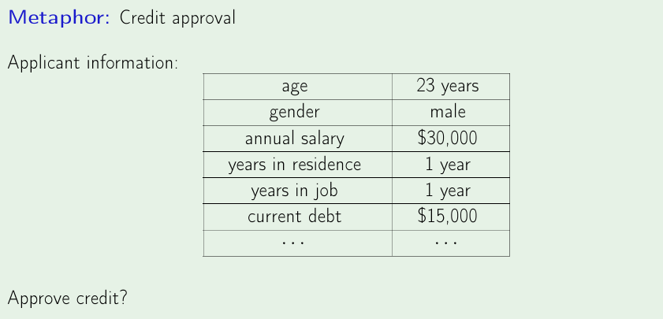
Bank Loan Approval

Slide 8
What Is Machine Learning
Wikipedia - Machine learning is a scientific
discipline that explores the construction and study of algorithms that can learn from data
Algorithms that can improve their performance using data

Slide 9
What We Will Do Using Machine Learning
Creating programs that can automatically learn rules/patterns from data

Slide 10
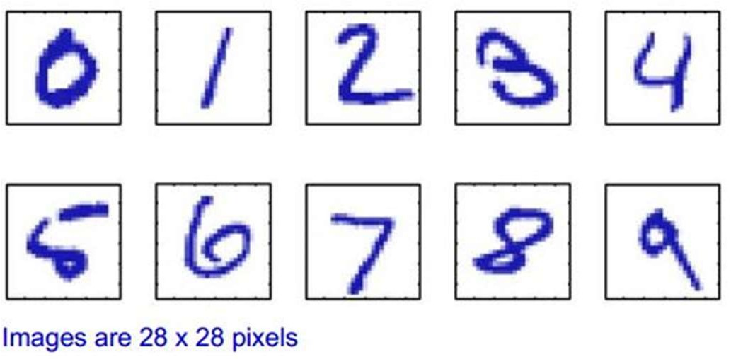
Example – Character Recognition(Classification)
Lets say we have 1000 worked-out examples
We can then train an algorithm with these examples, which can then recognize unseen examples

Slide 11


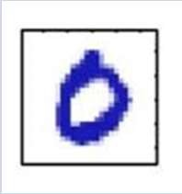
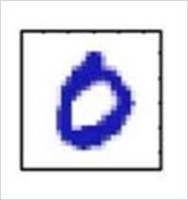
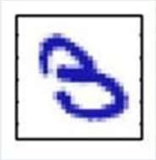
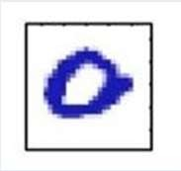
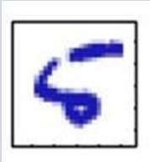
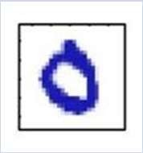
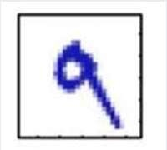
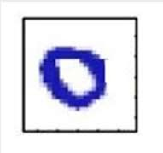
Training Examples (MNIST)
Image
Classification
Image
Classification
Zero
Zero
Three
Zero
Five
Zero
Nine
Zero

Slide 12

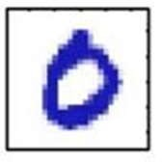
ZERO
Input / Unknown Example
Learning Algorithm
Training Examples

Slide 13
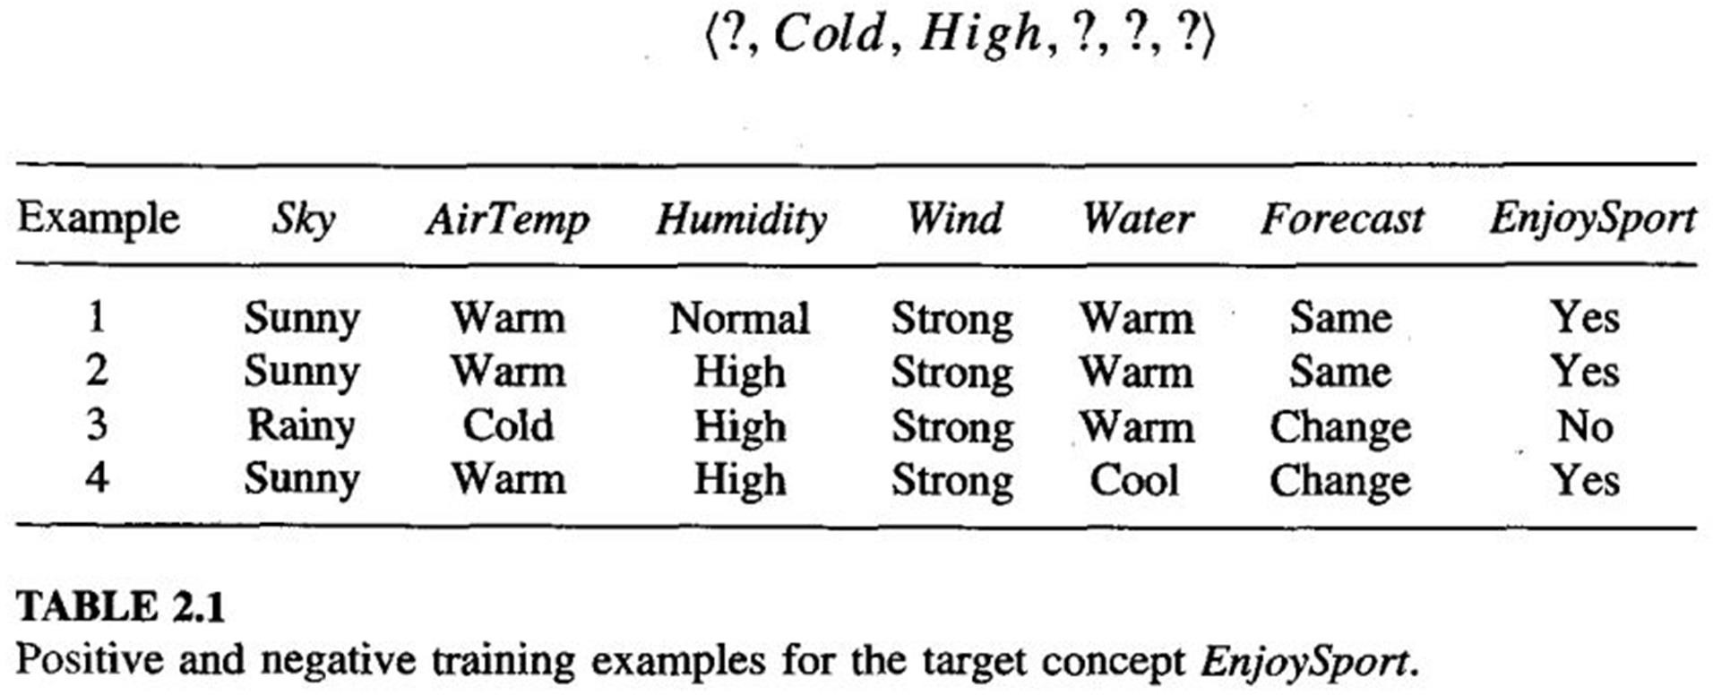
Enjoy Sports (Classification)

Slide 14

Function Approximation/Regression
We have information about Tamim Iqbal’s last 100 One Day innings
Weather Venue Pitch Day/Night … Run
Cold Mild Sunny
Mirpur Auckland Lords
Flat Green Dusty
Yes Yes No
…
…
…
15
54
83
…
…
…
…
…
…
What will be Tamim Iqbal’s score if?
– Weather – Mild, Pitch – Flat, Venue-Dhaka D/N- No

Slide 15
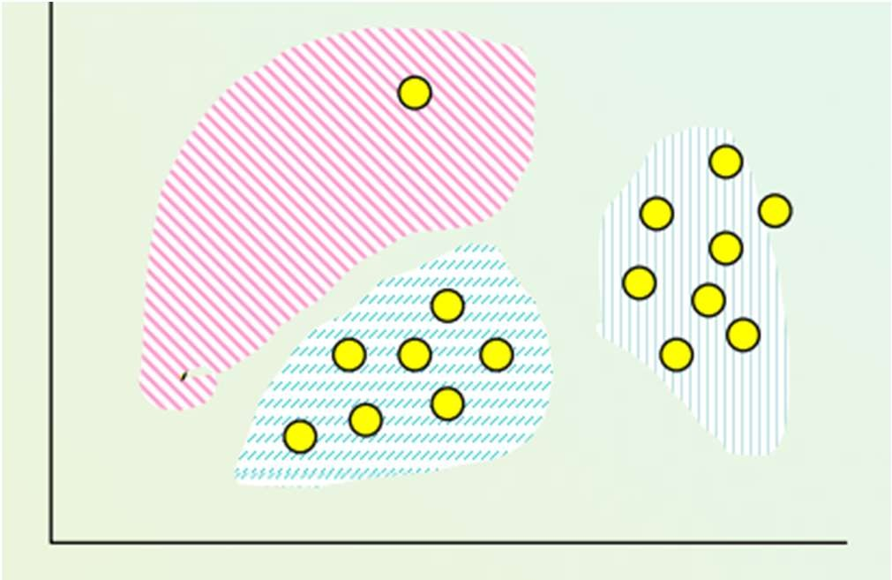
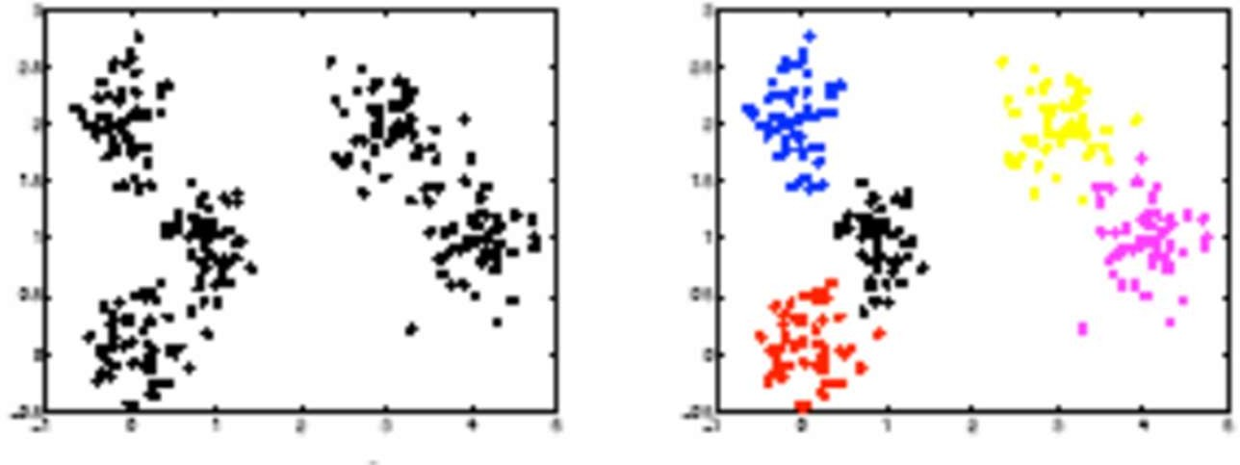
Clustering

Slide 16
Learning
Learning can be classified as follows
Supervised Learning
Unsupervised Learning
Reinforcement Learning

Slide 17
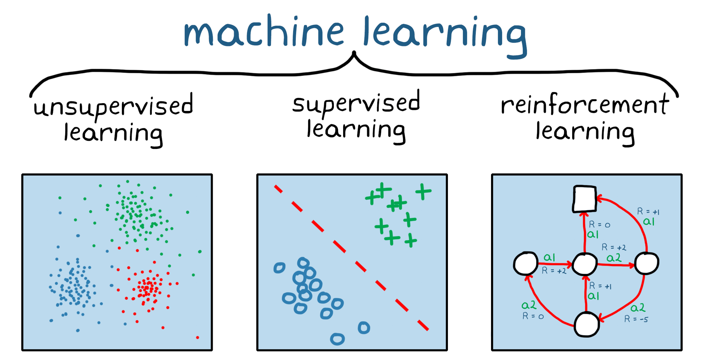
Learning

Slide 18
Supervised Learning
The agent observes some example input output pairs and learns a function that maps from input to output
Two basic types
Classification
Regression

Slide 19
Supervised Learning
Labeled Examples
Given input-output pairs as example
Learns a function/hypothesis that maps input to output
– Can be thought as there is a teacher/oracle who gives you “labeled examples”

Slide 20
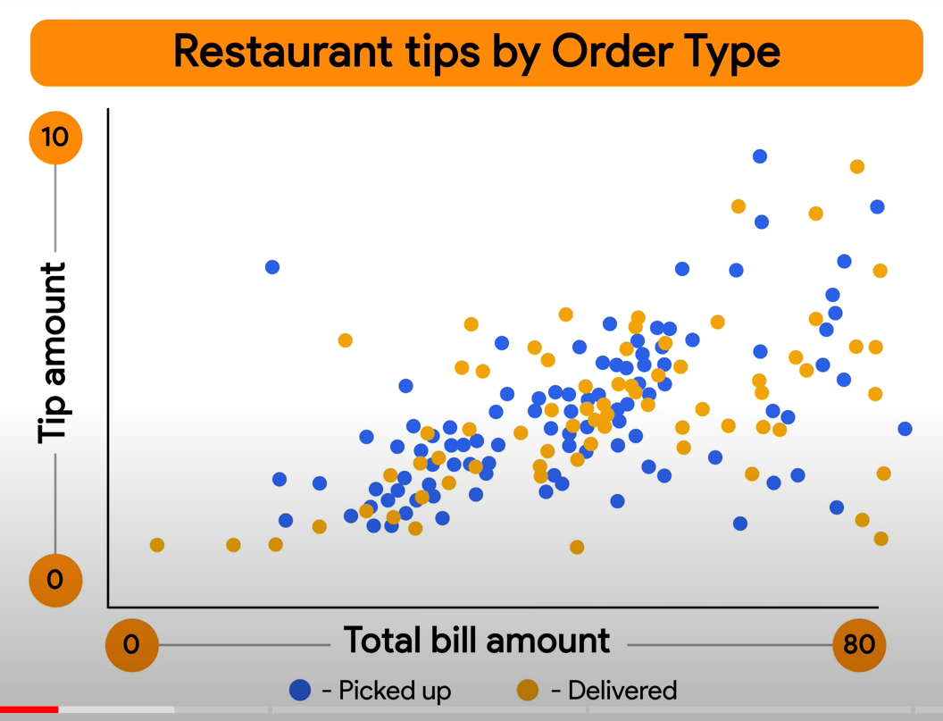
Supervised Learning

Slide 21
Find a problem that falls under supervised learning

Slide 22
Supervised Learning Scenarios
Face Recognition
Character Recognition
Document Classification
Sentiment Analysis
Disease Detection

Slide 23
Unsupervised Learning
The agent learns patterns in the input even though no explicit feedback is supplied.
The most common unsupervised learning task is clustering.

Slide 24
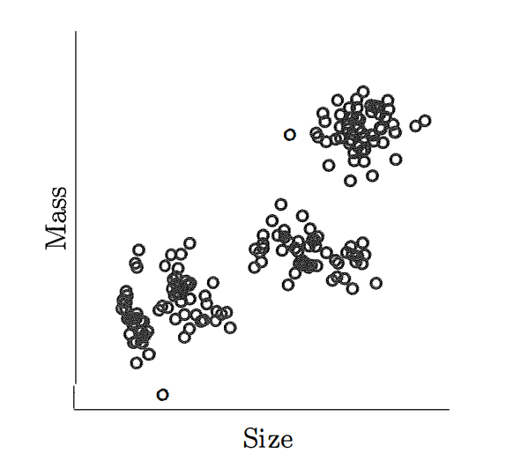
Unsupervised Learning

Slide 25
Reinforcement Learning
The agent learns from a series of reinforcements
– rewards or punishments

Slide 26
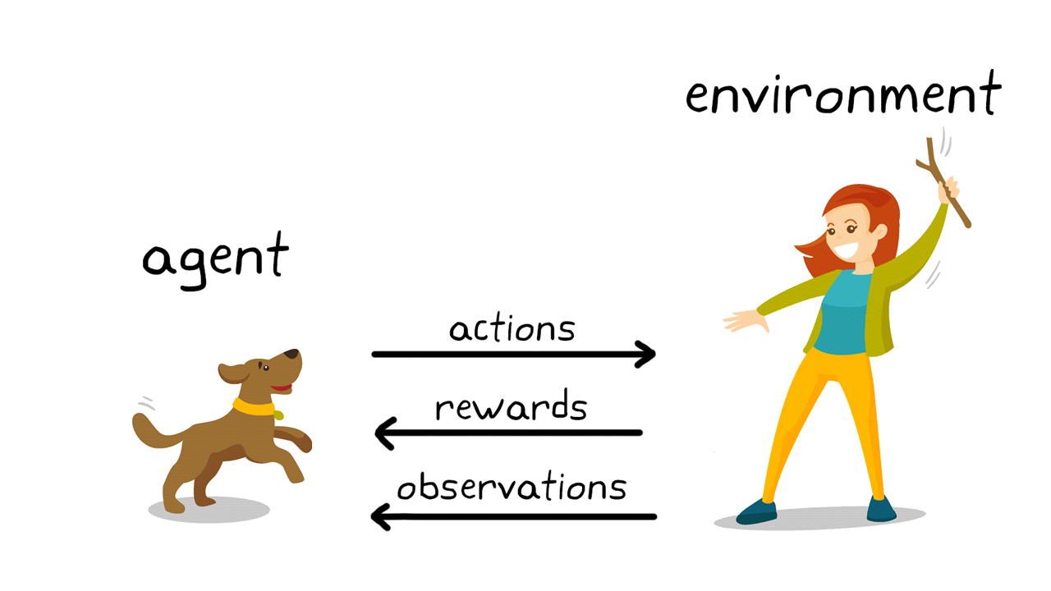
Reinforcement Learning
Notes:
image_source: https://www.mathworks.com/discovery/reinforcement-learning.html

Slide 27
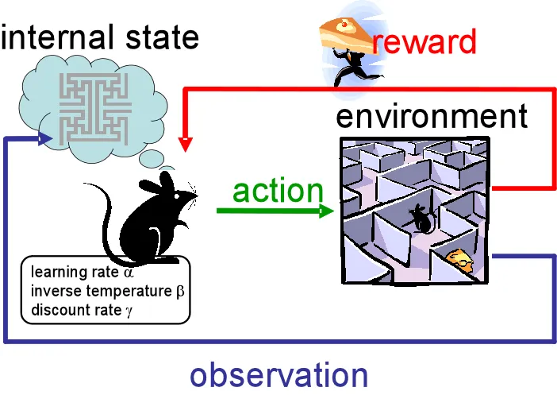
Reinforcement Learning
Notes:
image_source: https://www.mathworks.com/discovery/reinforcement-learning.html

Slide 28
Some Applications of Reinforcement Learning
Autonomous vehicle
Robotics
Artificial game agent (such as AlphaGo)

Slide 29
What is the difference between reinforcement learning and supervised learning ????

Slide 30
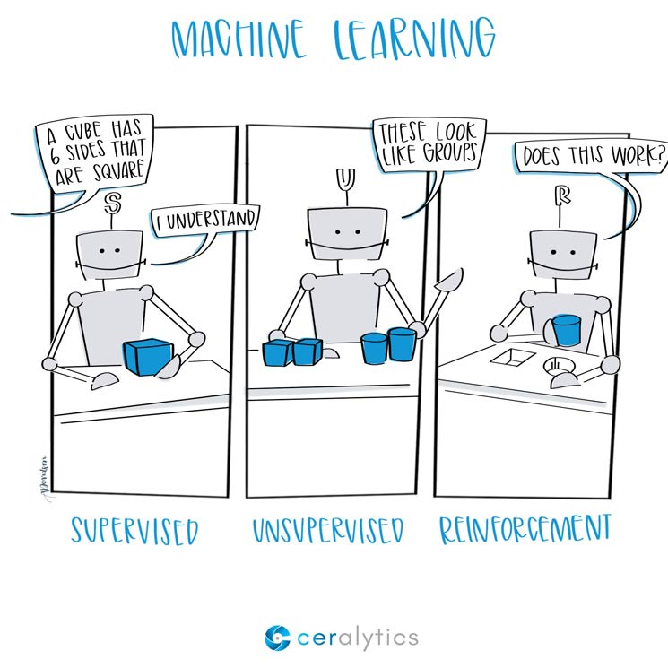
Three Main Types of Learning
The three main types arise based on the type of feedback that the agent gets from the environment.

Slide 31
The importance of feature vector
in case of supervised learning
The features should actually have effect on the classification.

Slide 32
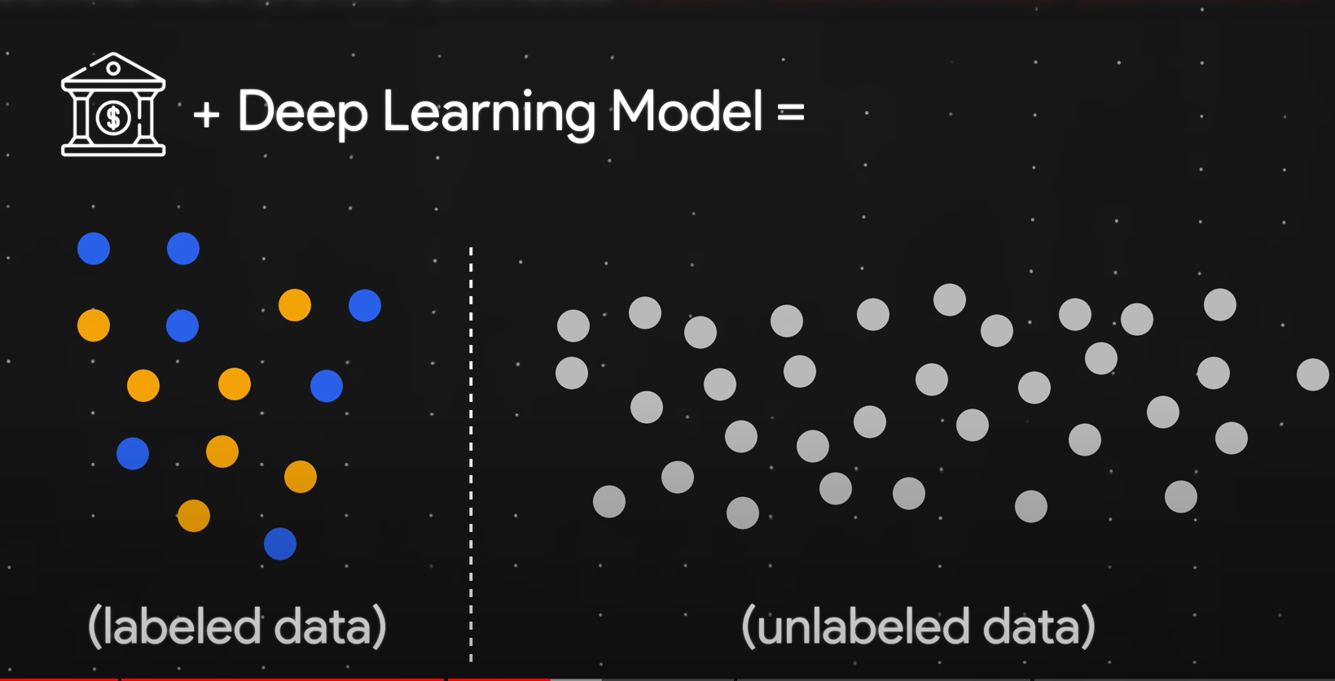
Semi-Supervised Learning
Uses a small amount of labeled data with a large amount of unlabeled data

Slide 33
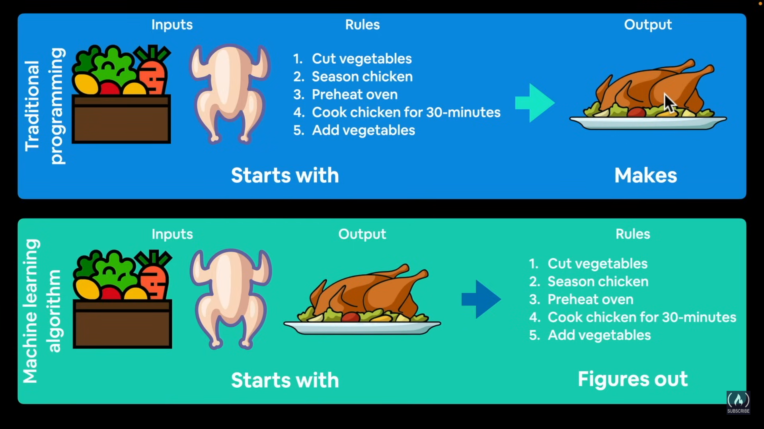
Traditional Algorithms vs Machine Learning Algorithms

Slide 34
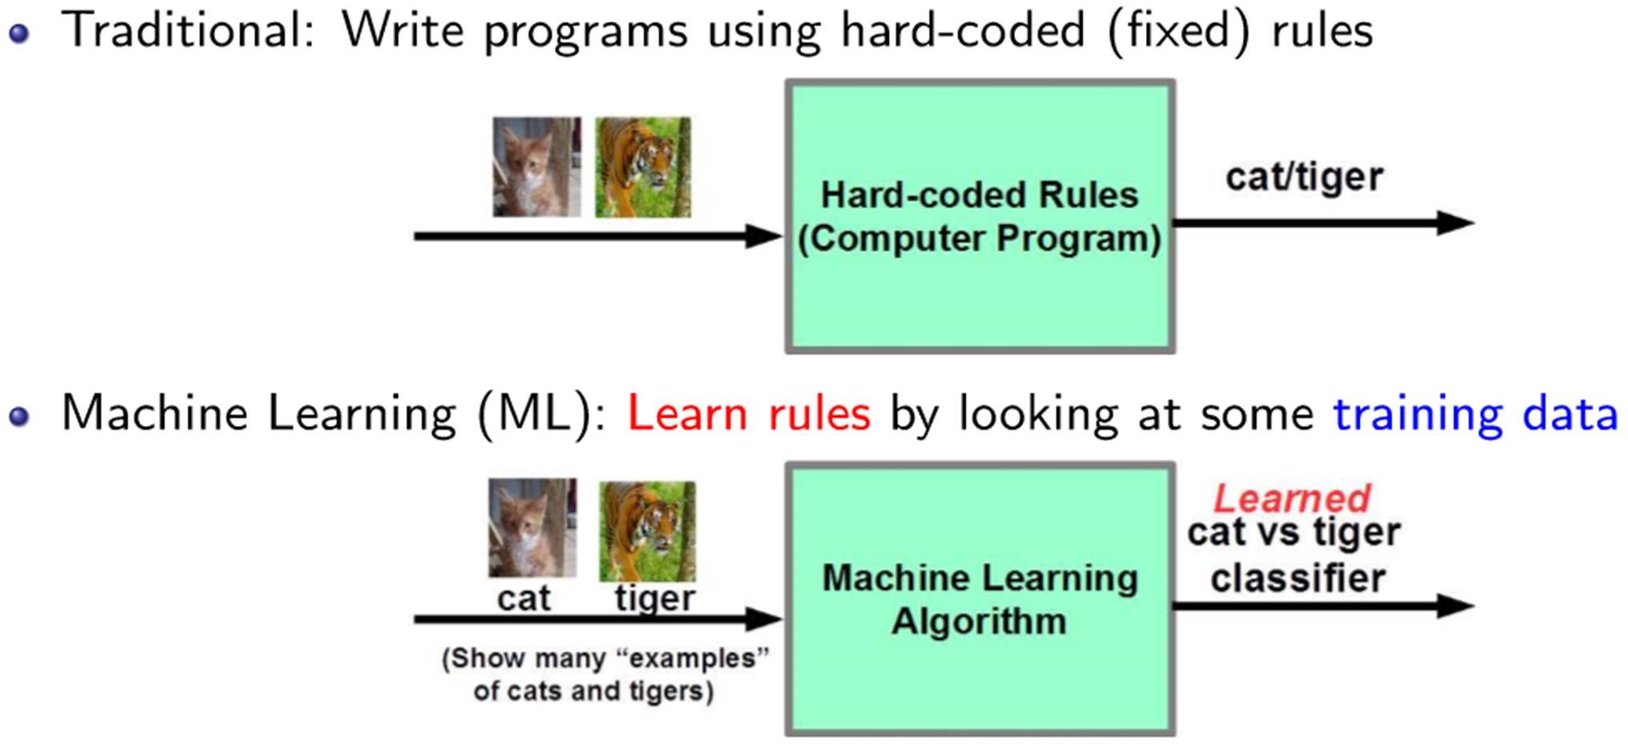
Traditional Algorithms vs Machine Learning Algorithms

Slide 35
Some real-world applications
Information retrieval (text, visual, and multimedia searches)
Machine Translation
Question Answering
Social networks
Recommender systems (Amazon, Netﬂix, etc.)

Slide 36
Some real-world applications
Speech/handwriting/object recognition
Ad placement on websites
Credit-card fraud detection
Weather prediction
Autonomous vehicles (self-driving cars)
Healthcare and life-sciences
... and many more applications in sciences and engineering

Slide 37
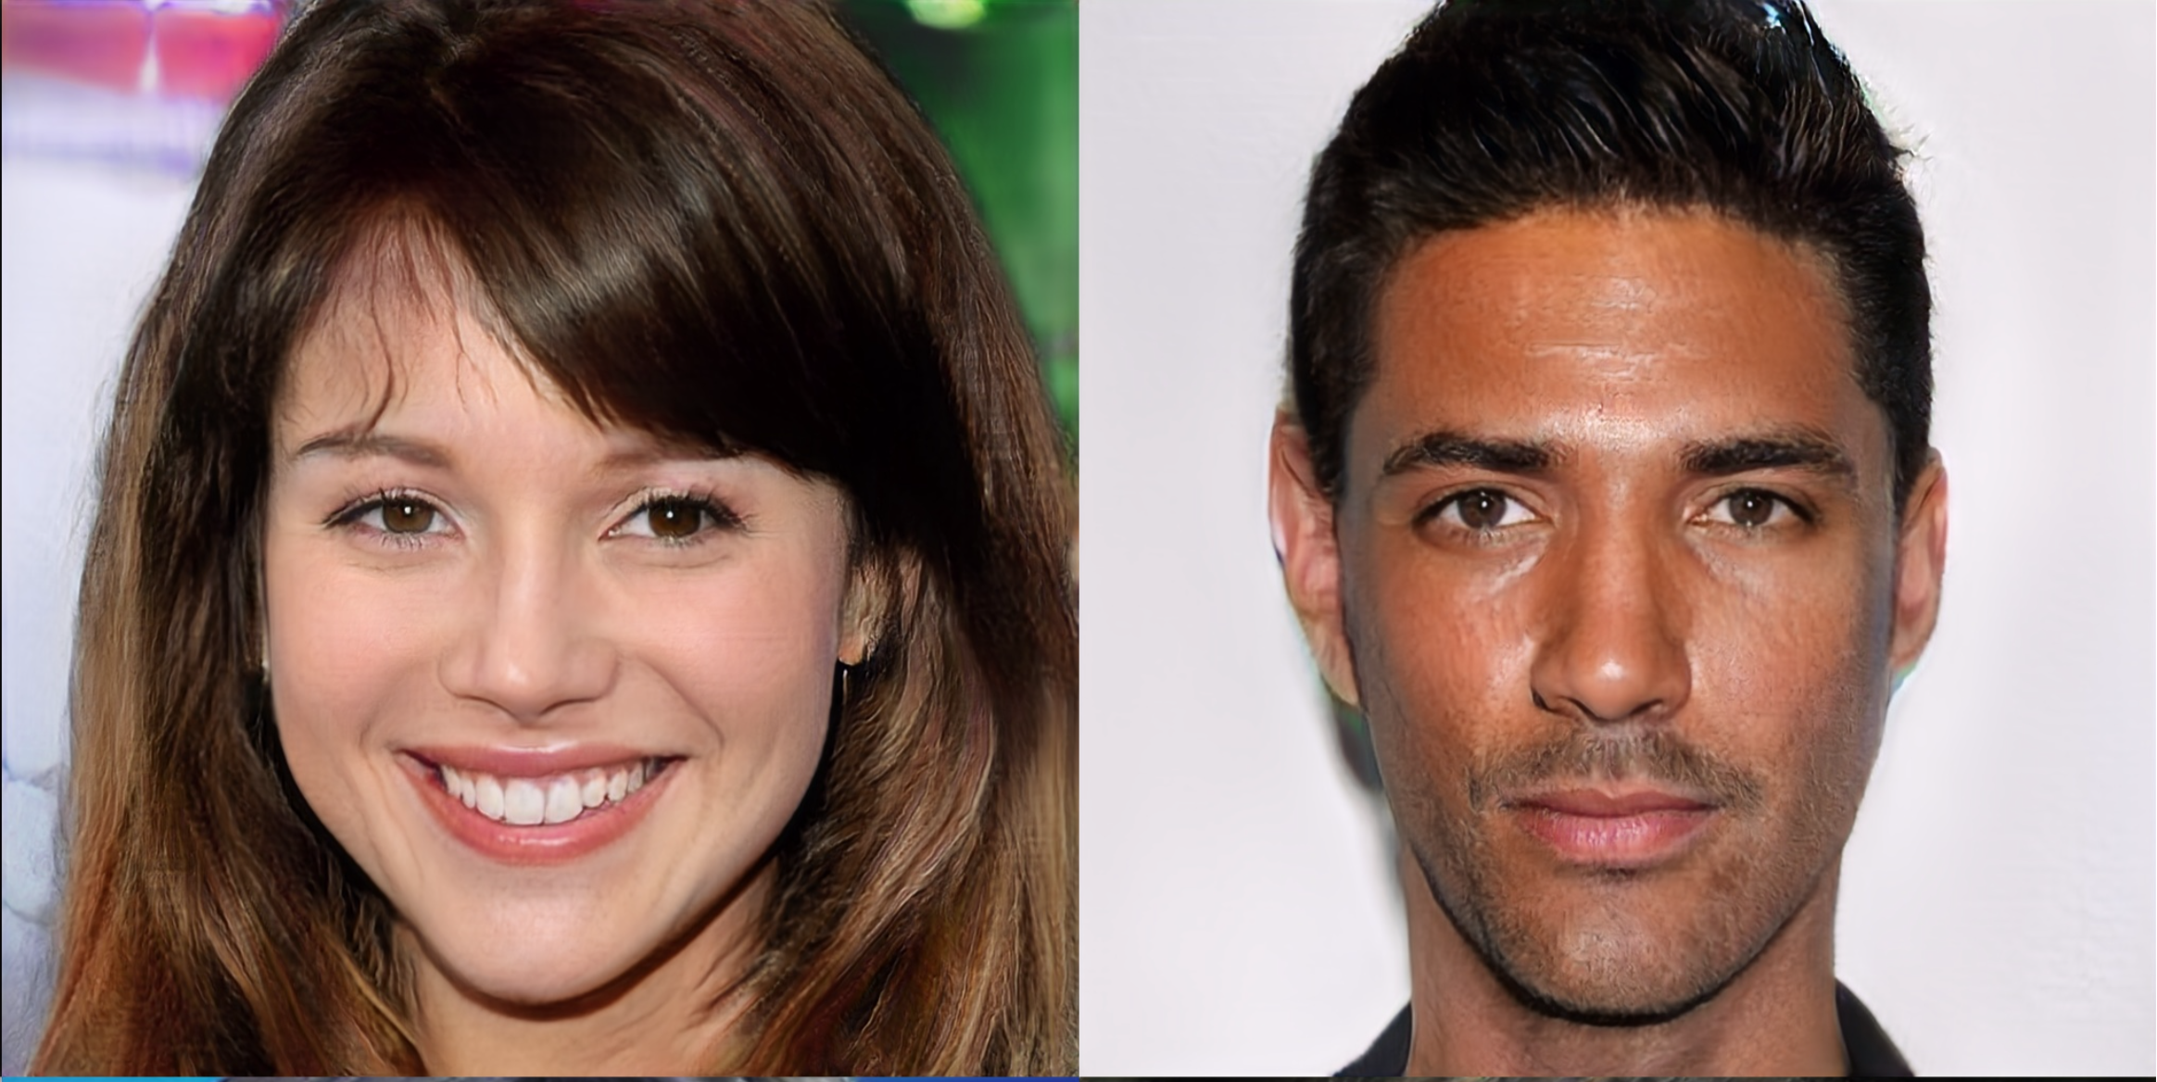
These are not real people!
Generated by ProGAN, developed by NVIDIA

Slide 38
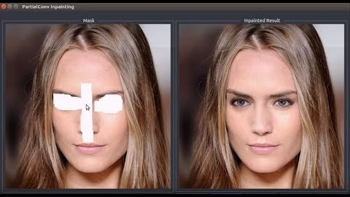
Filling up holes in photo

Slide 39
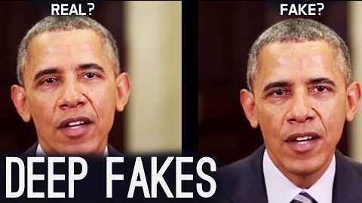
DeepFake

Slide 40
Data Sets
https://archive.ics.uci.edu/datasets
– Old : http://kdd.ics.uci.edu/

Slide 41
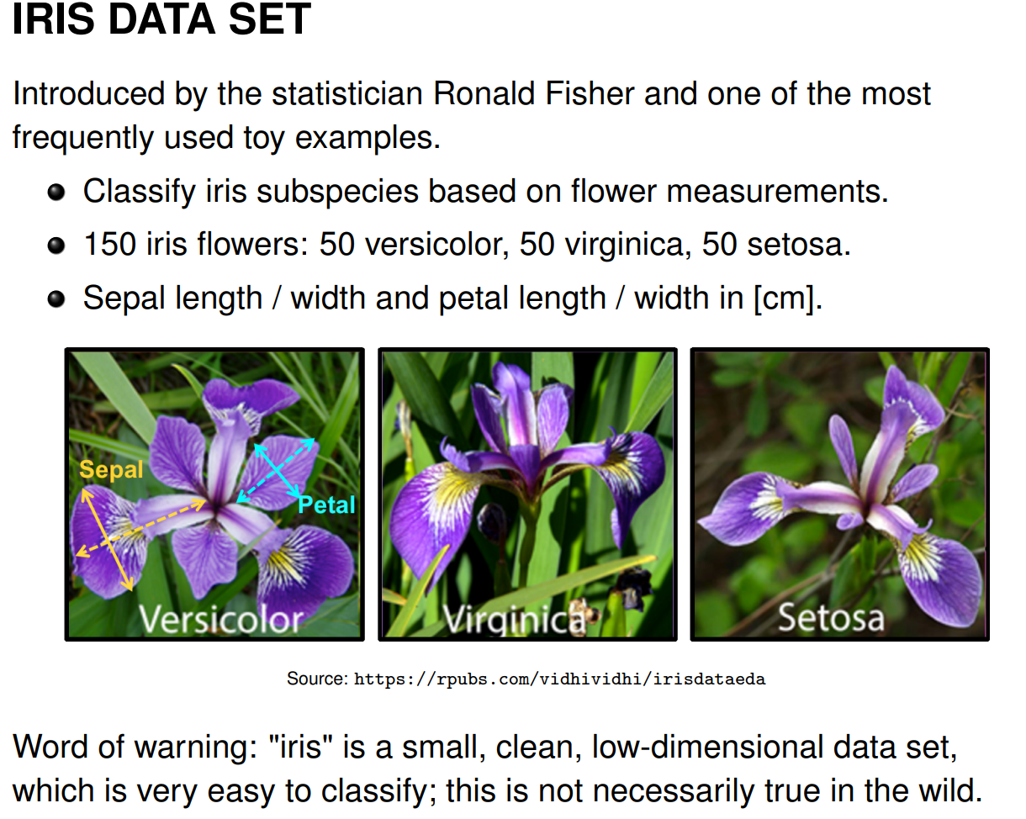

Slide 42
Resources
Google
Machile Learning by Tom Mitchell
https://towardsdatascience.com/progan-how-nvidia-generated-images-of-unprecedented-quality-51c98ec2cbd2
https://www.youtube.com/watch?v=dMF2i3A9Lzw
https://www.youtube.com/watch?v=147GawtmE8g
https://www.youtube.com/watch?v=gg0F5JjKmhA
https://towardsdatascience.com/applications-of-reinforcement-learning-in-real-world-1a94955bcd12
https://medium.com/@jrodthoughts/understanding-semi-supervised-learning-a6437c070c87
https://hackernoon.com/artificial-intelligence-vs-machine-learning-whats-the-difference-9e35u30a0

Slide 43
Any Questions

